Slide 1


Joint Action
and Knowing Others’ Minds

Slide 2

Joint action:
a goal-directed action, or something resembling one, comprising two or more agents’ goal-directed activities.

Slide 3
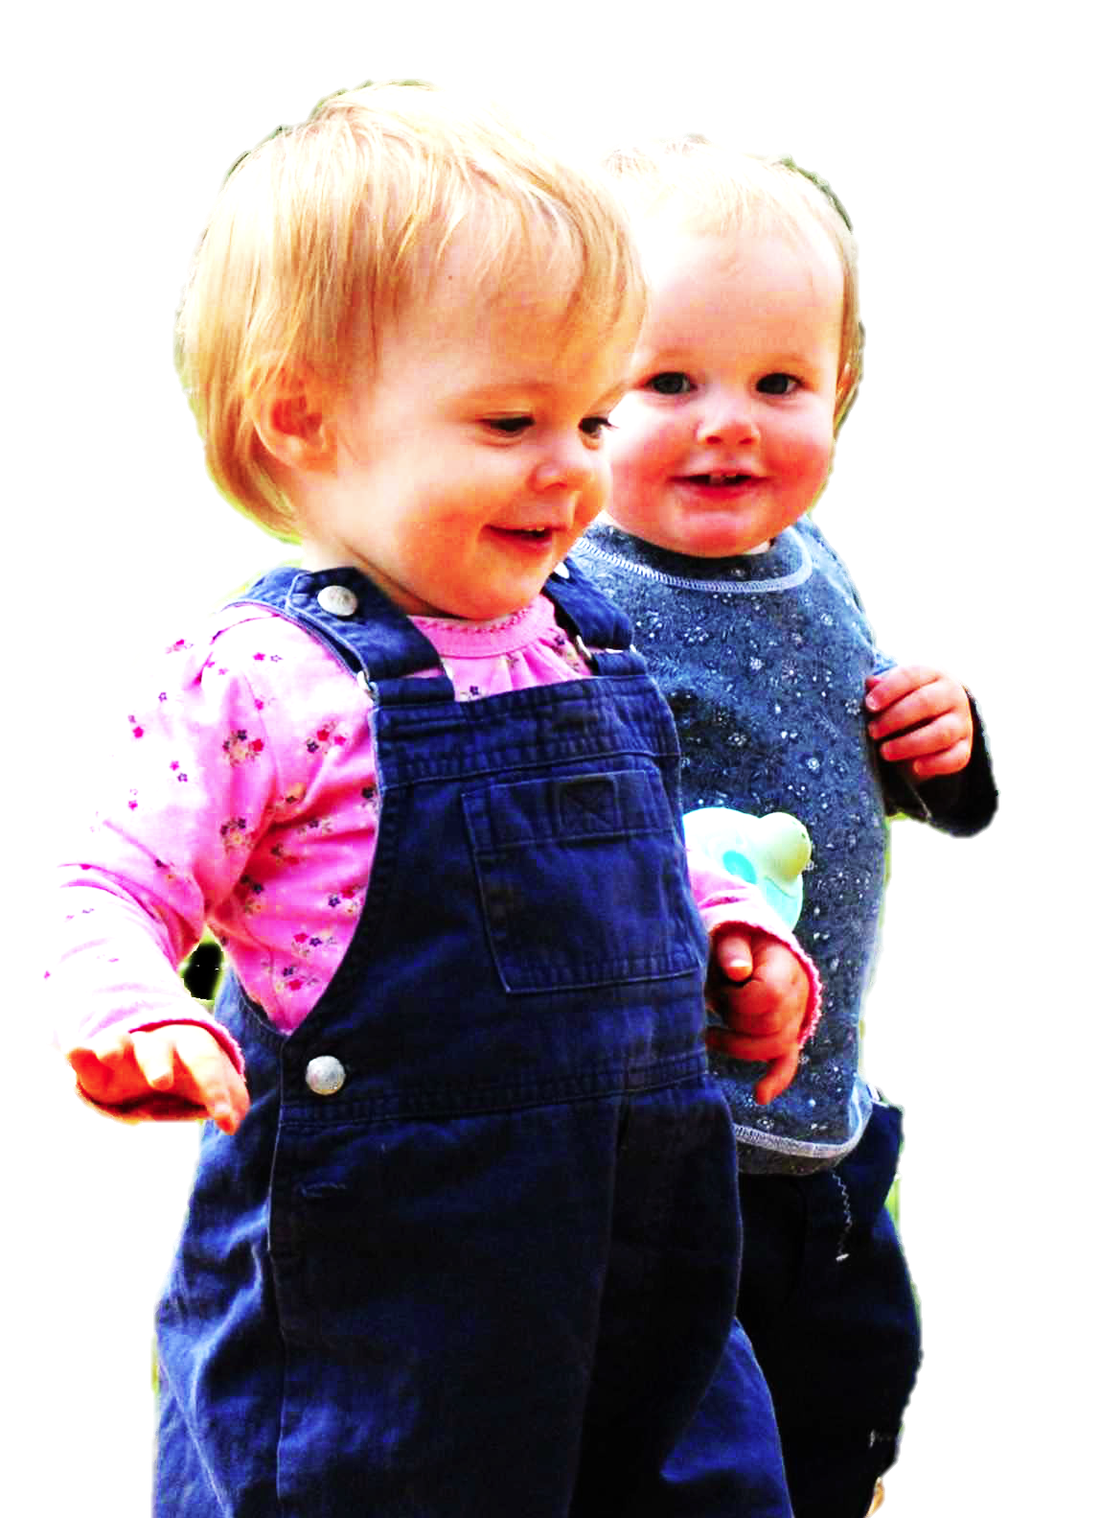
Joint action:
a goal-directed action, or something resembling one, comprising two or more agents’ goal-directed activities.
tidying up the toys together
(Behne et al 2005)
cooperatively pulling handles in sequence to make a dog-puppet sing
(Brownell et al 2006)
bouncing a ball on a large trampoline together
(Tomasello & Carpenter 2007)
pretending to row a boat together

Slide 4

first
question
mindreading in joint action

Slide 5
‘I take a collective action to involve a collective [shared] intention.’
(Gilbert 2006, p. 5)
‘The sine qua non of collaborative action is a joint [shared] goal and a joint commitment’
(Tomasello 2008, p. 181)
‘the key property of joint action lies in its internal component [...] in the participants’ having a “collective” or “shared” intention.’
(Alonso 2009, pp. 444-5)
‘Shared intentionality is the foundation upon which joint action is built.’
(Carpenter 2009, p. 381)

Slide 6
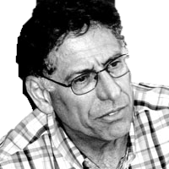
Substantial account
We have a shared intention that we J =
“1. (a) I intend that we J and (b) you intend that we J
“2. I intend that we J in accordance with and because of la, lb, and meshing subplans of la and lb; you intend [likewise] …
“3. 1 and 2 are common knowledge between us”
(Bratman 1993: View 4)

Slide 7
Substantial account
We have a shared intention that we J =
“1. (a) I intend that we J and (b) you intend that we J
“2. I intend that we J in accordance with and because of la, lb, and meshing subplans of la and lb; you intend [likewise] …
“3. 1 and 2 are common knowledge between us”
(Bratman 1993: View 4)
{
Intentions about intentions

Slide 8
Substantial account
We have a shared intention that we J =
“1. (a) I intend that we J and (b) you intend that we J
“2. I intend that we J in accordance with and because of la, lb, and meshing subplans of la and lb; you intend [likewise] …
“3. 1 and 2 are common knowledge between us”
(Bratman 1993: View 4)
{
Intentions about intentions
{
Knowledge of others’ knowledge of intentions about intentions

Slide 9
1. All (significant) joint actions require shared intention.
2. Shared intention requires sophisticated mindreading abilities.
Therefore:
3. Abilities to engage in joint action could play no significant facilitative role in explaining the development, or the evolution, of mindreading abilities.

Slide 10
1. All (significant) joint actions require shared intention.
2. Shared intention requires sophisticated mindreading abilities.
Therefore:
3. Abilities to engage in joint action could play no significant facilitative role in explaining the development, or the evolution, of mindreading abilities.

Slide 11
1. All (significant) joint actions require shared intention.
2. Shared intention requires sophisticated mindreading abilities.
Therefore:
3. Abilities to engage in joint action could play no significant facilitative role in explaining the development, or the evolution, of mindreading abilities.

Slide 12
What is the relation between an action and the goal (or goals) to which it is directed?

Slide 13
What is the relation between an action and the goal (or goals) to which it is directed?
out
out
act
out
out

Slide 14
What is the relation between an action and the goal (or goals) to which it is directed?
out
out
act
out
out

Slide 15
What is the relation between an action and the goal (or goals) to which it is directed?
out
out
act
out
intention or other goal-state
out

Slide 16
What is the relation between an action and the goal (or goals) to which it is directed?
teleological function
out
out
act
out
intention or other goal-state
out

Slide 17
What is the relation between an action and the goal (or goals) to which it is directed?
teleological function
out
out
act
out
intention or other goal-state
It is possible to represent goal-directed actions without representing intentions.
out

Slide 18
out
out
act
out
out

Slide 19
Joint action: a goal-directed action, or something resembling one, comprising two or more agents’ goal-directed activities.
out
out
act
out
out

Slide 20
Joint action: a goal-directed action, or something resembling one, comprising two or more agents’ goal-directed activities.
out
out
act
out
act
out

Slide 21
Joint action: a goal-directed action, or something resembling one, comprising two or more agents’ goal-directed activities.
G is a distributive goal: it is an outcome to which each agent’s activities are individually directed and it is possible that: all agents succeed relative to this outcome.

Slide 22
Joint action: a goal-directed action, or something resembling one, comprising two or more agents’ goal-directed activities.
G is a distributive goal: it is an outcome to which each agent’s activities are individually directed and it is possible that: all agents succeed relative to this outcome.
G is a collective goal
(a) it is a distributive goal;
(b) the agents’ activities are coordinated; and
(c) this type of outcome would normally be facilitated by this type of coordination.

Slide 23
Joint action: a goal-directed action, or something resembling one, comprising two or more agents’ goal-directed activities.
G is a distributive goal: it is an outcome to which each agent’s activities are individually directed and it is possible that: all agents succeed relative to this outcome.
G is a collective goal
(a) it is a distributive goal;
(b) the agents’ activities are coordinated; and
(c) this type of outcome would normally be facilitated by this type of coordination.

Slide 24
Joint action: a goal-directed action, or something resembling one, comprising two or more agents’ goal-directed activities.
G is a distributive goal: it is an outcome to which each agent’s activities are individually directed and it is possible that: all agents succeed relative to this outcome.
G is a shared goal
G is a collective goal
(a) it is a distributive goal;
(b) the agents’ activities are coordinated; and
(c) this type of outcome would normally be facilitated by this type of coordination.
Each agent expects each of the other agents to perform activities directed to the goal.
Each agent expects the goal to occur as a common effect of all their goal-directed actions.

Slide 25
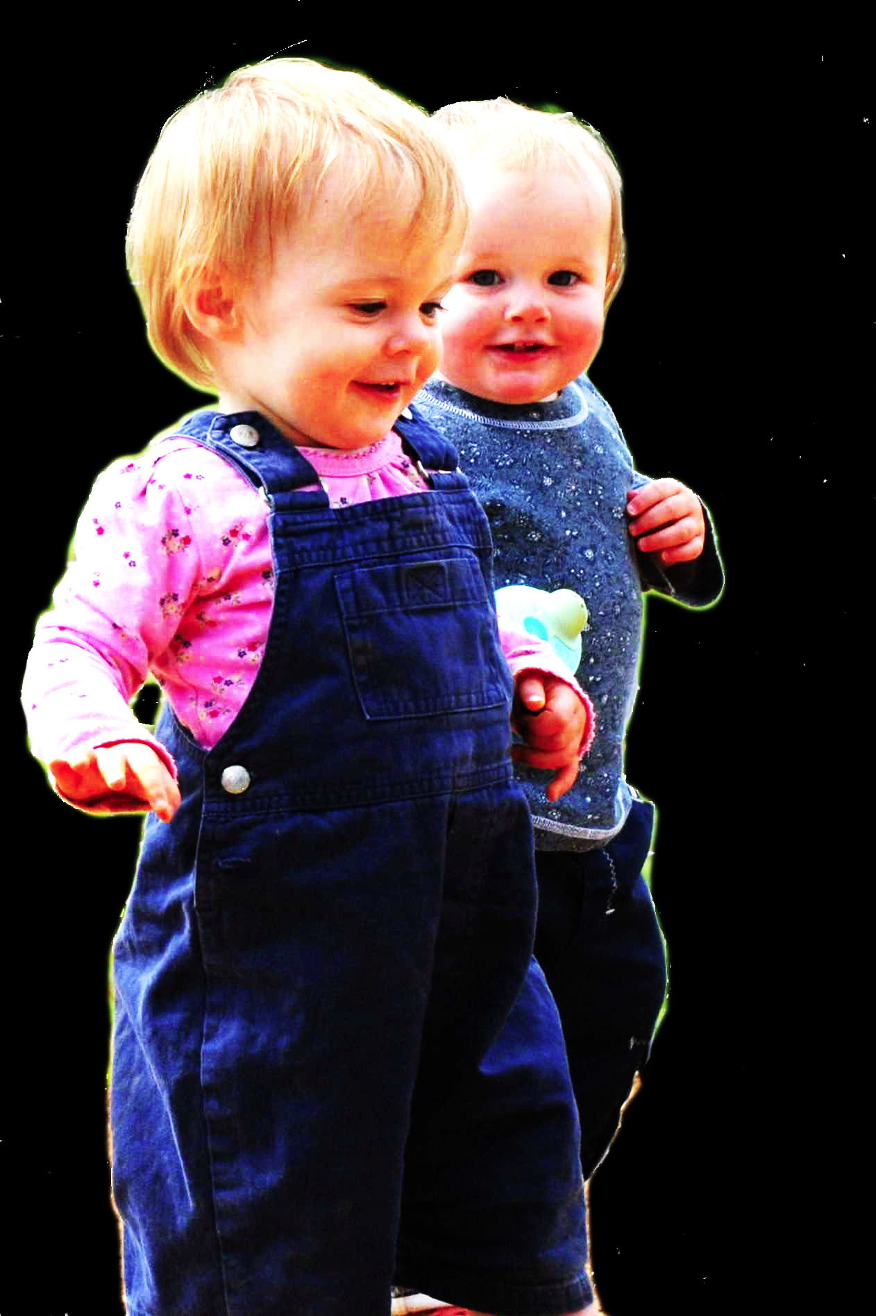
second
question
Notes:
This is an overview of the project and its aims

Slide 26
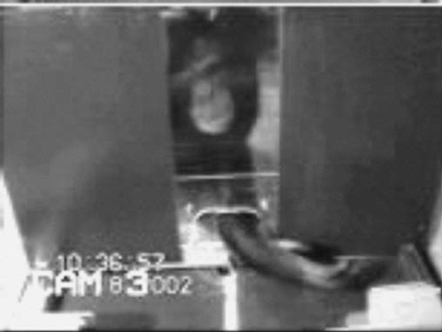

failed reach
point
source: Hare & Tomasello (2004)
Notes:
this illustrates problem of identifying particular goals of action

Slide 27
The problem of opaque means

Slide 28
The problem of false belief

Slide 29
your-goal-is-my-goal

Slide 30
your-goal-is-my-goal
1. We are about to engage in some joint action* or other
2. I am not about to change my goal.
Therefore:
3. Your actions also will be directed to this goal.
[*in at least the minimal sense associated with distributive goals]

Slide 31
failed reach
point
source: Hare & Tomasello (2004)

Slide 32
failed reach
point
source: Hare & Tomasello (2004)
“to understand pointing, the subject needs to understand more than the individual goal-directed behaviour. She needs to understand that ... the other attempts to communicate to her ... and ... the communicative intention behind the gesture”
(Moll & Tomsello 2007)

Slide 33
Csibra’s ‘two stances’:
Teleological and referential action interpretation ‘rely on different kinds of action understanding’
These are initially two distinct ‘action interpretation systems’ and they come together later in development
Csibra (2003, p. 456)

Slide 34

minimal mindreading abilities
ability to share goals
understanding communicative intent
other stuff
communication by language
other stuff
full mindreading abilities

Slide 38




first
question
role of mindreading in joint action

Slide 39


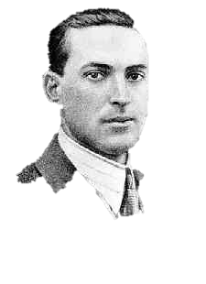
Joint action:
a goal-directed action, or something resembling one, comprising two or more agents’ goal-directed activities.
“regular participation in cooperative, cultural interactions during ontogeny leads children to construct uniquely powerful forms of cognitive representation.”
(Moll & Tomasello 2007)
“perception, action, and cognition are grounded in social interaction”
(Sebanz & Knoblich 2008)

